Slide 1
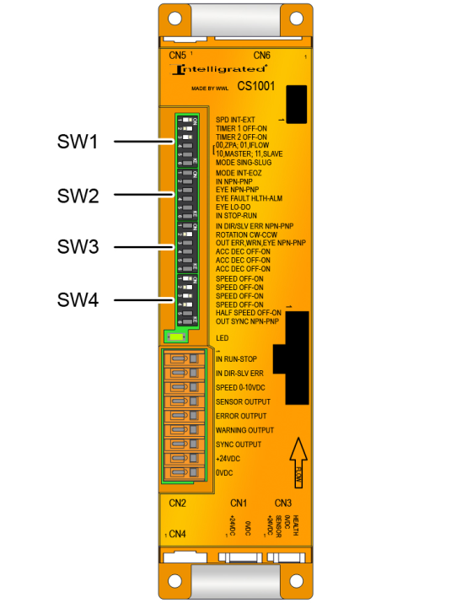
WWL CS1001 General Settings & LED

Slide 2


Speed Selection (SW1)
Speed controlled internally by SW4-1 - SW4-4
Speed controlled externally by 0-10V and CN2-3.
SW1-1
SW1-1
v2.0 7/18
WWL (CS1001) General Settings & LED

Slide 3





Operating Modes (SW1)
ZPA Singulation Release Mode
ZPA Slug Release Mode
IFlow
Master (Must be same speed as Slave)
Slave (Must be same speed as Master)
SW1-4, SW1-5, SW1-6
SW1-4, SW1-5, SW1-6
SW1-4, SW1-5
SW1-4, SW1-5
SW1-4, SW1-5
v2.0 7/18
WWL (CS1001) General Settings & LED

Slide 4




Zone Type (SW2)
Intermediate Zone
End of Zone (EOZ)
SW2-1
SW2-1
ZPA operating modes only.
Input Signal Polarity (SW2)
NPN Mode
PNP Mode
SW2-2
SW2-2
v2.0 7/18
WWL (CS1001) General Settings & LED

Slide 5




Photo-Eye Operation (SW2)
PNP Output/Dark Operate
PNP Output/Light Operate
NPN Output/Dark Operate
NPN Output/Light Operate
SW2-3, SW2-5
SW2-3, SW2-5
SW2-3, SW2-5
SW2-3, SW2-5
v2.0 7/18
WWL (CS1001) General Settings & LED

Slide 6




Forcing a Zone (SW2)
Forced ON remotely (Run Zone)
Forced OFF remotely (Stop Zone)
SW2-6
SW2-6
Remove the signal on CN2-1 to unforce the zone.
Photo-Eye Status (SW2)
Health Mode
Alarm Mode
SW2-4
SW2-4
v2.0 7/18
WWL (CS1001) General Settings & LED

Slide 7




Roller Rotation Direction (SW3)
NPN/Clockwise
NPN/Counterclockwise
PNP/Clockwise
PNP/Counterclockwise
SW3-1, SW3-2
SW3-1, SW3-2
SW3-1, SW3-2
SW3-1, SW3-2
If a ZPA operating mode is in use, setting CN2-2 to 24 volts reverses the direction of roller rotation.
v2.0 7/18
WWL (CS1001) General Settings & LED

Slide 8


Output Signal Polarity (SW3)
NPN Mode
PNP Mode
SW3-3
SW3-3
v2.0 7/18
WWL (CS1001) General Settings & LED

Slide 9



Half Speed Mode (SW3, SW4)
Enable Half Speed Mode
One Zone Look Ahead
Two Zone Look Ahead
SW3-6
SW4-5
SW4-5
v2.0 7/18
WWL (CS1001) General Settings & LED

Slide 10

Synchronization Signal Polarity (SW4)
NPN Mode
PNP Mode
SW4-6
SW4-6
v2.0 7/18
WWL (CS1001) General Settings & LED

Slide 11
LED Diagnostics
The green LED to the right of the dipswitches provides alerts to status and error conditions that have occurred. The number of times the LED blinks identifies the error. If multiple errors have occurred, the LED will identify each error in the order in which it occurred. When this is the case, the LED will stay ON for 3 seconds between each error sequence. For example, if a Photo-Eye Error occurred followed by a Roller Thermal Fault, the LED would blink as follows:
1 Blink – ON (3 secs) – 4 Blinks – ON (3 secs) - Repeat
# of Blinks | Status
Steady ON | Normal Operation
1 | Photo-Eye Error
2 | Jam Time Error
3 | Control Card Thermal Fault
4 | Roller Thermal Fault
5 | Roller Lock/Over-Current Fault
6 | Power/Low-Voltage Error
7 | Slave Card Error (Master Mode)
v2.0 7/18
WWL (CS1001) General Settings & LED

